Slide 1
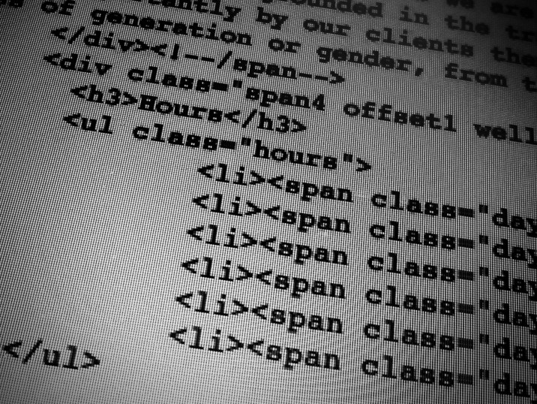

Lunch & Learn: CSS
Oct 23 & 30 2013 // bswift

Slide 2
What we will talk about:
Front-end vs Back-end coding at bswift
Defining HTML, CSS and Javascript How the client stylesheets work Examples
Tools

Slide 3

Let’s get started!

Slide 4
Static Pages / Dynamic Pages

Slide 5
SERVER
page.html
page.html
page.html
A static website is a group of self-contained, individual pages (or page), sent to the browser from the server one-page-at-a-time.

Slide 6
SERVER
page.html
.net
SQL databases
HTML
Dyamic web content is built when it is requested, by the user directly, or programmatically while a user is on a page (e.g., facebook updates).
Most websites contain both static and dynamic elements.

Slide 7
front-end
HTML CSS
Javascript
SERVER REQUEST
Can I have a webpage, please?
thanks!
.net
SERVER RESPONSE
SQL databases
back-end “recipe”

Slide 8
Server-side / Client-side
aka
Back End / Front-end

Slide 9
.net
page.html
SERVER
BROWSER
.asp
style.css
SQL
etc
script.js
Client-side (front-end) coding includes HTML, CSS and Javascript. This just means that our code will be downloaded from the server and then compiled entirely in the browser.

Slide 10
HTML, CSS, Javascript

Slide 11
Three layers of web design:
Structure, Style, Behavior

Slide 12



BEHAVIOR
Javascript
PRESENTATION
CSS
Imagery
STRUCTURE
HTML markup Site planning

Slide 13
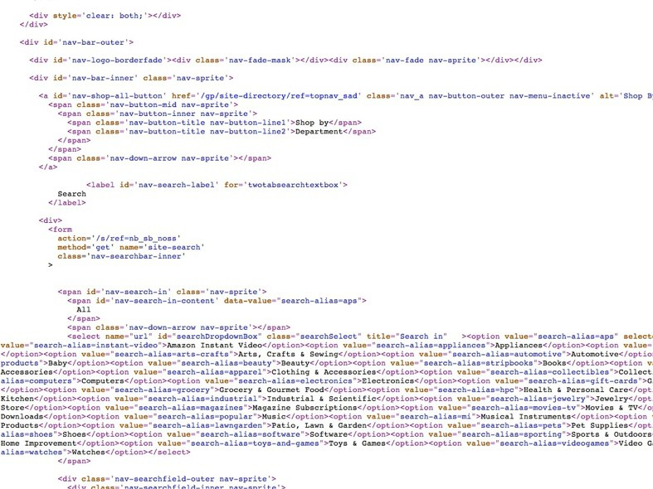

Slide 14
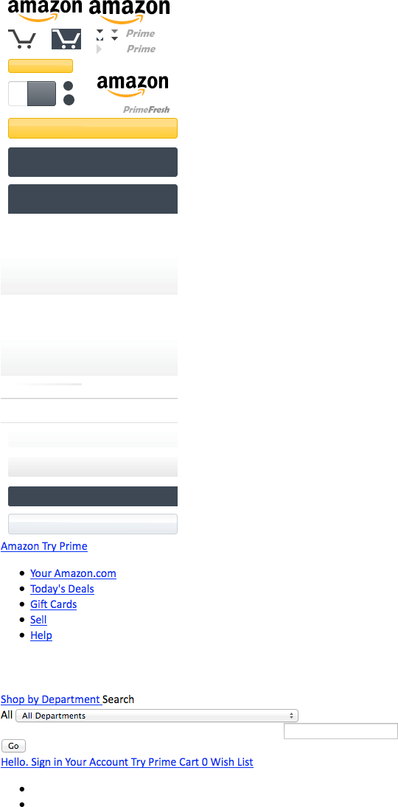

Slide 15
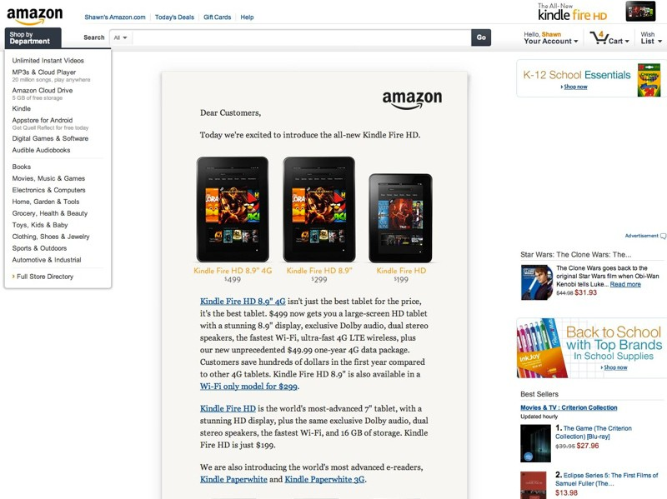

Slide 16


Slide 17
HTML

Slide 18
Hyper Text
+
Markup Language

Slide 19



Hyper Text

Slide 20
Markup Language
A markup language is a set of markup tags.
The purpose of the tags is to group and describe page content.

Slide 21
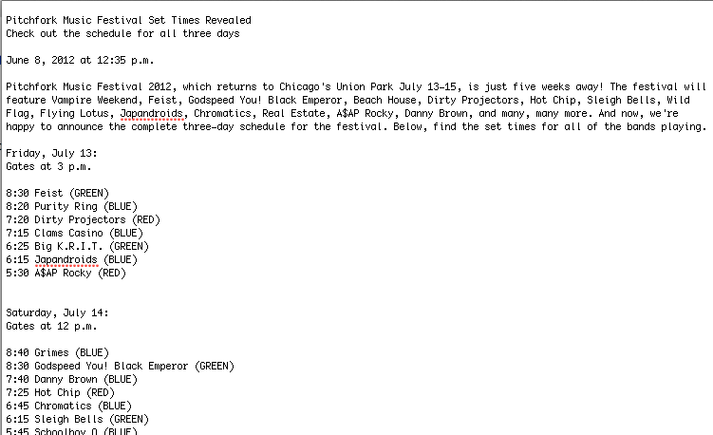
Markup Language
Without any markup to give your content structure, the browser renders unformatted and unstyled text, also known as “plain text”.

Slide 22
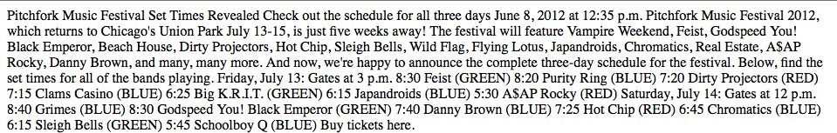

Slide 23
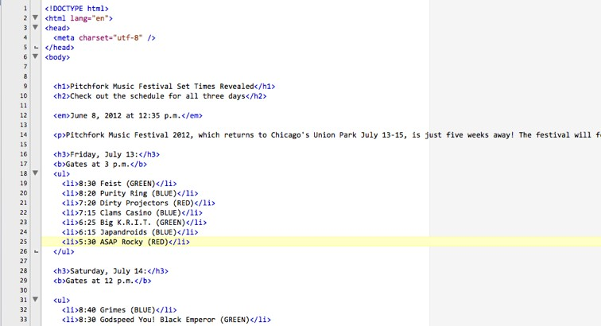
Markup Language
HTML tags give structure and meaning to your content. “Semantic markup” refers to the use of meaningful tags to describe content (e.g. using header tags for header content).

Slide 24
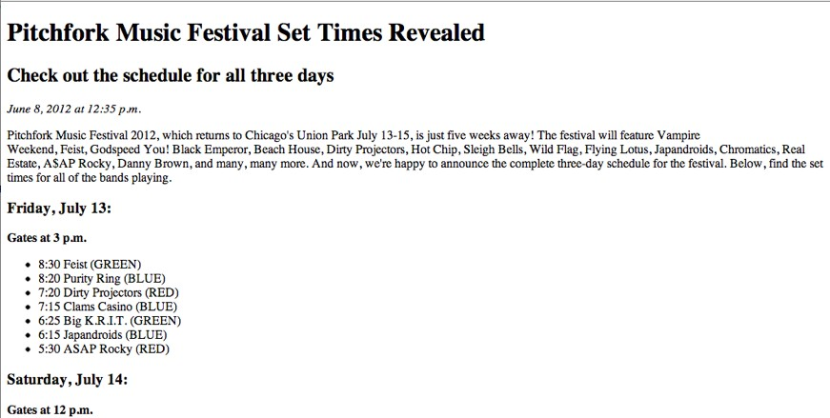
Markup Language
Once your content is marked up, the browser applies built-in default styles to the tags. While you can override these styles with css, your marked up, non-css styled document should be readable and have a clear hierarchy.

Slide 25
doctype html head body

Slide 26
<!DOCTYPE html>
EXCEPTION
The doctype is not actually a tag, but a declaration, telling the browser what kind of html you are using. The doctype above declares HTML 5.

Slide 27
<html></html>
The <html> element defines the whole HTML document.

Slide 28
<head></head>
The <head> element contains special elements that instruct the browser where to find stylesheets, provide meta info, and more.

Slide 29
<body></body>
The <body> element contains the document content (what is shown
inside the browser window).

Slide 30
Nesting
The use of our first three tags (html, head and body), introduces and important concept: Nesting, which is when tags “wrap” other tags. When you create markup, you should indicate nesting by indenting the nested tags with 2 spaces (preferred) or a tab.
<html>
<head> </head>
<body>
<h1></h1>
<p></p>
</body>
</html>

Slide 31
Document Hierarchy: Parents, children and siblings
Just as in a genealogy tree, the family hierarchy is described in terms of relationships. All elements in the document have a parent (up to ‘document’, which is at the top), and may have children (nested inside) or siblings (placed alongside).
<parent x>
<child and sibling y> </child and sibling y>
<child and sibling z> </child and sibling z>
</parent x>

Slide 32
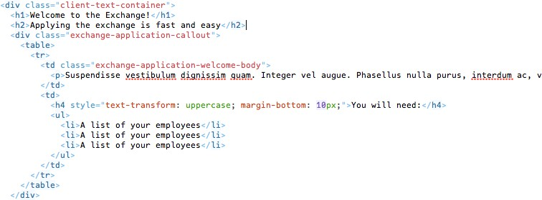
The ‘address’ of an element
The document hierarchy provides us with an ‘address’ for each element.
in the div with class “client-text-container”, make all of the h2 elements orange and 24px.

Slide 33
HTML Elements

Slide 34
Anatomy of an Element
<tag>Content</tag>
An HTML element includes both the HTML tag and everything between
the tag (the content).

Slide 35
Anatomy of an Element
<tag>Content</tag>
Tags normally come in pairs. The
first tag is the start tag, and the second tag is the end tag.

Slide 36
Anatomy of an Element
<h1>Main Headline</h1>
HTML has a defined set of tag names (also called keywords) that the browser understands.

Slide 37
The essential element tags
Primary Structure
html head body
Structural Elements (block)
p br
h1 – h6 ul
ol a
img (div)
Formatting Elements (inline)
em i
strong b
q
blockquote (span)
Head Elements
title meta link

Slide 38
Anatomy of an Element
<html lang=”en”></html>
Most elements can have attributes, which provides additional information about the element.

Slide 39
Anatomy of an Element
<div class=”left-nav”></div>
Attributes always follow the same format: name=”value”. You can use either single or double quotes.

Slide 40
The essential attributes
link
<link rel=”stylesheet” type-”text/css” href=”stylesheet/styles.css”>
img <img src=”images/image.jpg” alt=”Sam”>
a
<a href=”http://colum.edu”>My school</a>

Slide 41
CSS

Slide 42
Cascading
+
Style Sheet

Slide 43
The Stylesheet
A stylesheet is a set of rules defining
how an html element will be “presented” in the browser.
These rules are targeted to specific elements in the html document.

Slide 44
The Cascade
The “cascade” part of CSS is a set of rules for resolving conflicts with multiple CSS rules applied to the same elements.
For example, if there are two rules defining the color or your h1 elements, the rule that comes last in the cascade order will “trump” the other.

Slide 45
Browser stylesheet
low importance
Linked (external) stylesheet
Embedded (internal) stylesheet Inline (internal) Styles
high importance

Slide 46
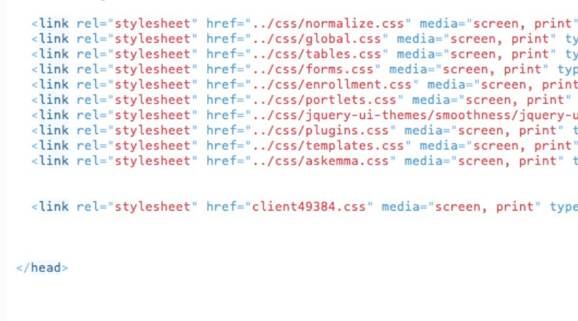

Slide 47
Inheritance
Most elements will inherit many style properties from their parent elements by default.
HTML
relationship
<body>
parent parent parent
of site
of ul and li, child of li, child of div
<div>
<ul>
of body and body
<li></li>
</ul>
</div>
</body>
child of ul, div, and body

Slide 48
Inheritance
body
make the paragraph 16px, Verdana, red
p
make the paragraph blue
16px, Verdana, blue

Slide 49
Specificity
Shortly after styling your first html elements, you will find yourself wanting more control over where your styles are applied.
This is where specificity comes in.
Specificity refers to how specific your selector is in naming an element.

Slide 50
Specificity
body
make the paragraph 16px, Verdana, red
p
make the paragraph blue
p.pink
make the paragraph pink
16px, Verdana, pink

Slide 51
<div
HTML
id=”plan-2323”>
<p>Here
<p>Hide
<div>
is some text.</p>
this text.</p>
<div id=”plan-2323”>
<p>Here is some text.</p>
<p class=”hideclass”>Hide this text.</p>
<div>
CSS
#plan-2323.hideclass
{display:
none}

Slide 52
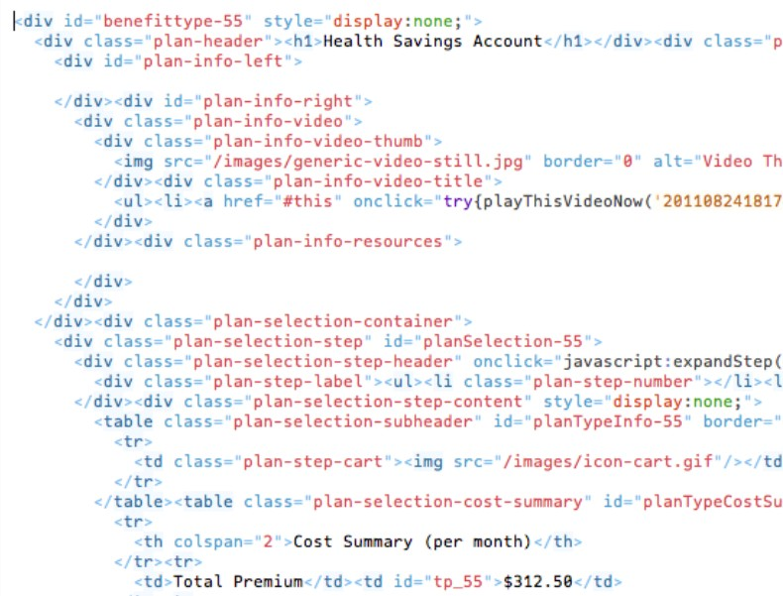

Slide 53
CSS Syntax
Syntax = the rules for how to write the language

Slide 54
Three terms for describing your styles:
CSS rule CSS selector
CSS declaration

Slide 55
CSS Rule
selector {property: value;}
declaration
Every style is defined by a selector and
a declaration. The declaration contains at least one property/value pair.Together they are called a CSS Rule.

Slide 56
CSS Selector
body
{font-family: Arial, Helvetica}
p {color: #666666} h1 {font-size: 24px} a
{color: blue}
The selector associates css rules with HTML elements.

Slide 57
CSS Selector
p {
color: red
}
The selector is typed in front of the declaration, with a space separating it and the opening curly-bracket (aka curly-brace).
Typically, extra spaces and returns are added as shown for the sake of readability.

Slide 58
CSS Selector
h1,h2,h3,h4 {
font-weight: bold
}
You can apply styles to multiple selectors in the same rule by separating the selectors with commas.

Slide 59
CSS Declaration
p {
property: value
}
The declaration is always defined in a property/ value pair. The two are separated by a colon.
How you define the properties will affect how HTML elements are displayed.

Slide 60
CSS Declaration
p {
font-family: Arial, sans-serif; font-size: 14px;
color: #666666;
}
You can apply multiple declarations to a selector(s) by separating the delcarations with semi-colons.

Slide 61
CSS Selectors

Slide 62
p Type (element)
# ID
. Class

Slide 63
Type (element) Selectors
body {declaration} p {declaration} h1 {declaration} ul {declaration}
The simplest selector is the type selector, which targets an html element by name.

Slide 64
The essential selector types (elements)
Primary | Body | Formatting
Structure | Elements | Elements
html | p | em
body | br | i
 | h1 – h6 | strong
 | ul | b
 | ol | q
 | a | blockquote
 | img | span
 | div

Slide 65
ID Selectors
CSS
#logo {declaration}
HTML
<img id=”logo” src=”” alt=””>
An ID is an html attribute that is added to your html markup. You reference that ID in your css with a hash.

Slide 66
Class Selectors
CSS
.ingredients {declaration}
HTML
<ul class=”ingredients”>
A class is an html attribute that is added to your html markup. You reference that ID in your css with a period.

Slide 67
IDs vs Classes
The most important difference between IDs and classes is that there can be only one ID on a page, but multiple classes.
An ID is more specific than a class.
An element can have both an ID and multiple classes.

Slide 68
IDs vs Classes
ID: #344-34-4344
Class: Male Class: Employee
ID: #123-54-9877
Class: Female Class: Employee

Slide 69
Descendant Selectors
CSS
#sidebar
.author
{declaration}
HTML
<div id=”sidebar”>
<p class=”author”></p>
</div>
A space between two selectors indicates a descendant selector. In the example above, the style is targeted to an element with the class “author” inside the id “sidebar”.

Slide 70
Multiple classes
CSS
.ingredients.time
{declaration}
HTML
<div class=”ingredients
<h1></h1>
</div>
time”>
Elements can have multiple classes, giving you more control. The are written in the CSS in the exact order they appear in the html, with no spaces.

Slide 71
bswift Client Stylesheets

Slide 72
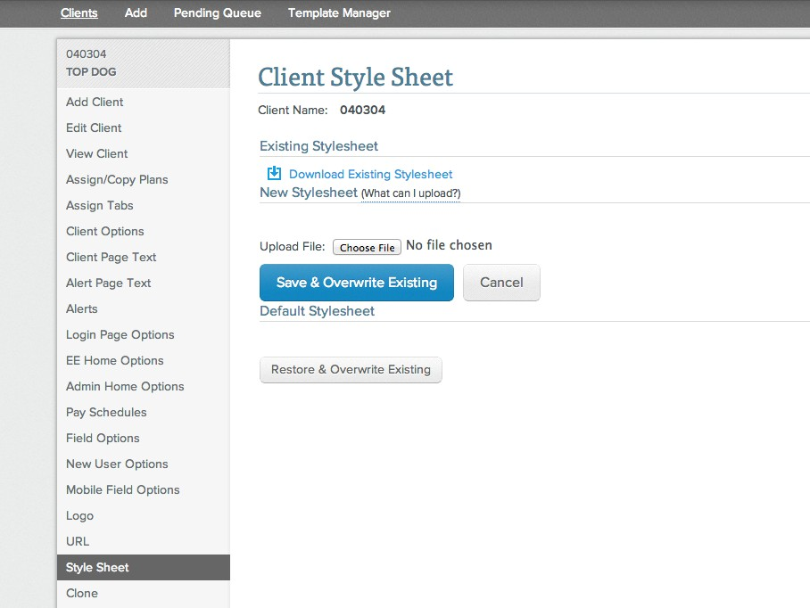

Slide 74
Common uses:
Hiding elements Tweaking specific text styles
Branding

Slide 75
Some things you can change with CSS
colors type type size
backgrounds spacing
sizes borders
positions (layout)
Some things you can’t change with CSS content
markup

Slide 76
Example:
Client text + Client CSS

Slide 77
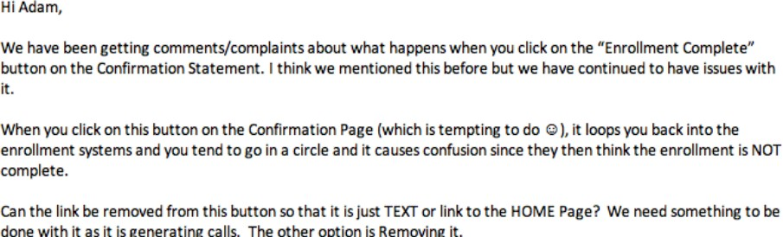
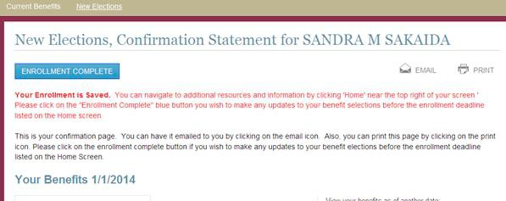

Slide 78
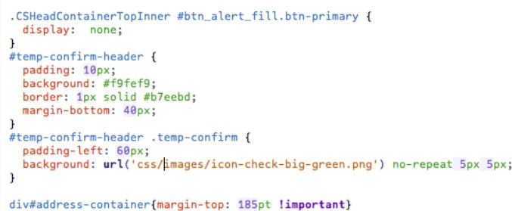
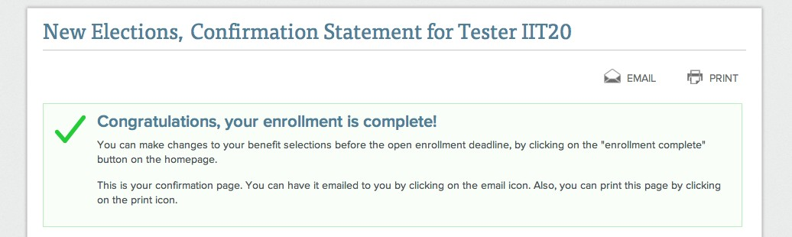

Slide 79
Example:
Login Branding

Slide 80
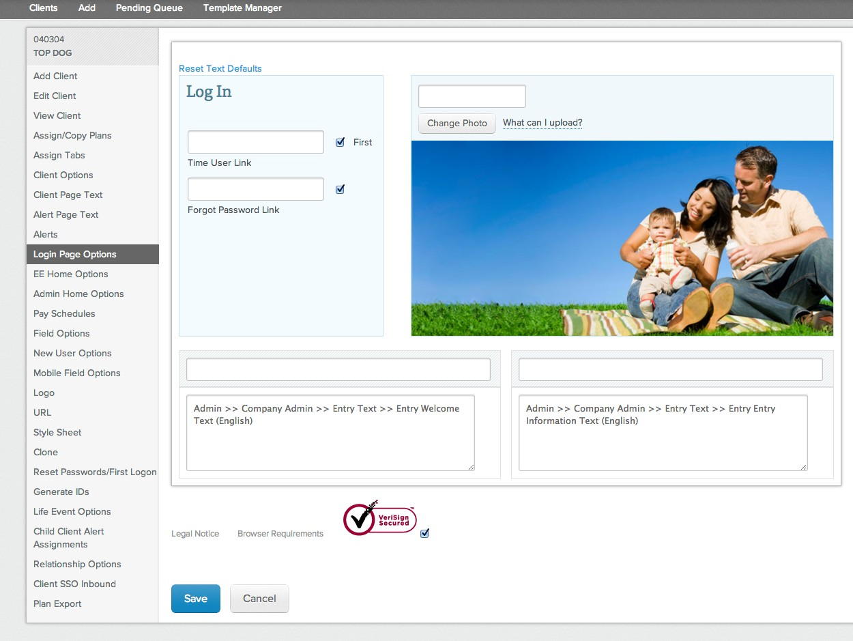

Slide 81
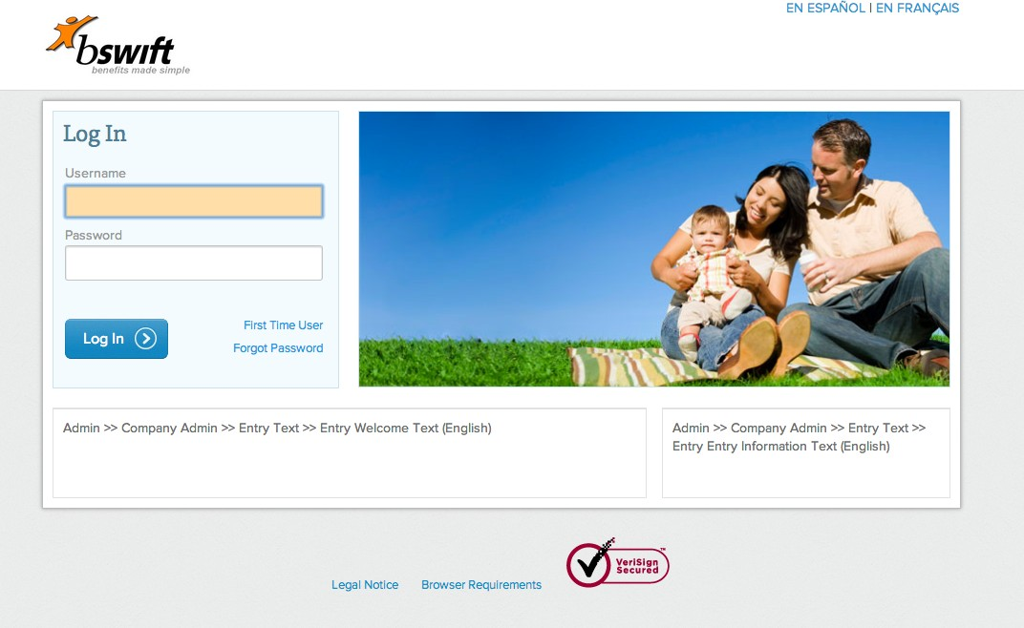

Slide 82


Slide 83


Slide 84


Slide 85
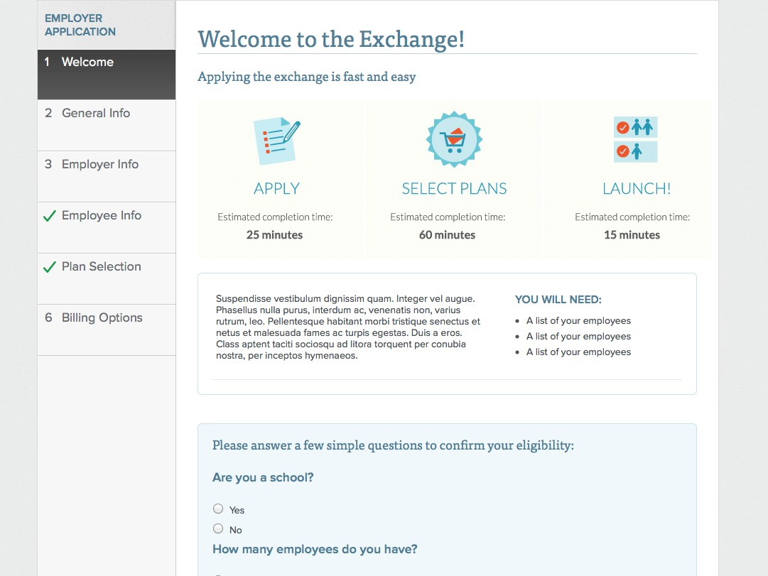

Slide 86
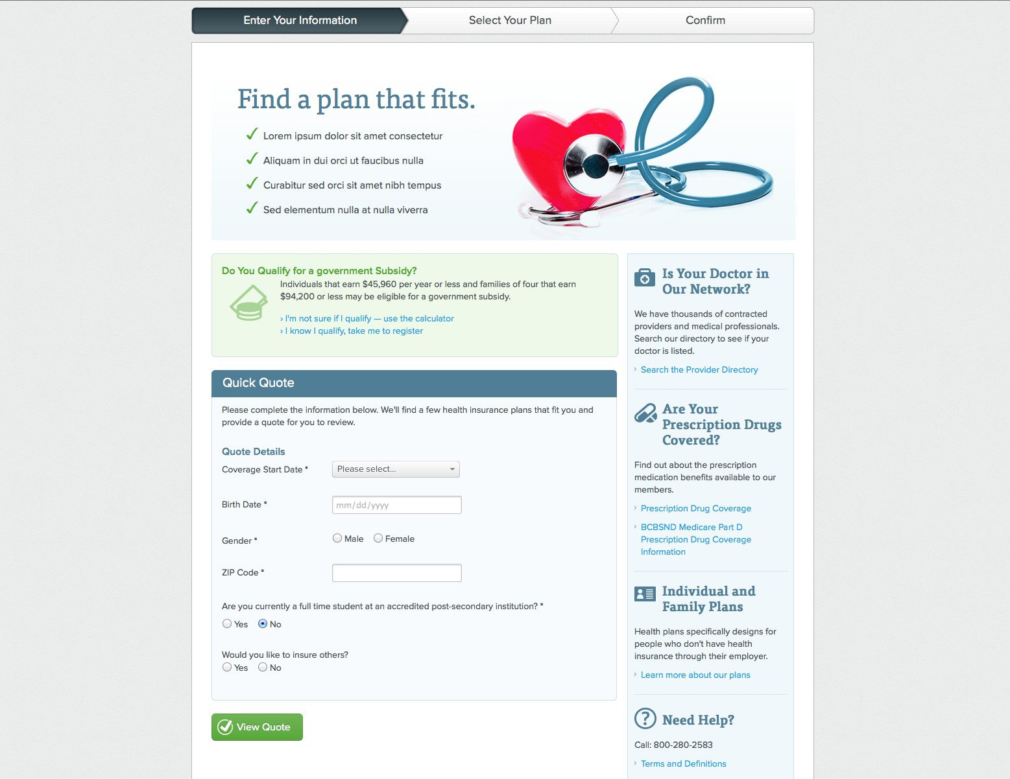

Slide 87
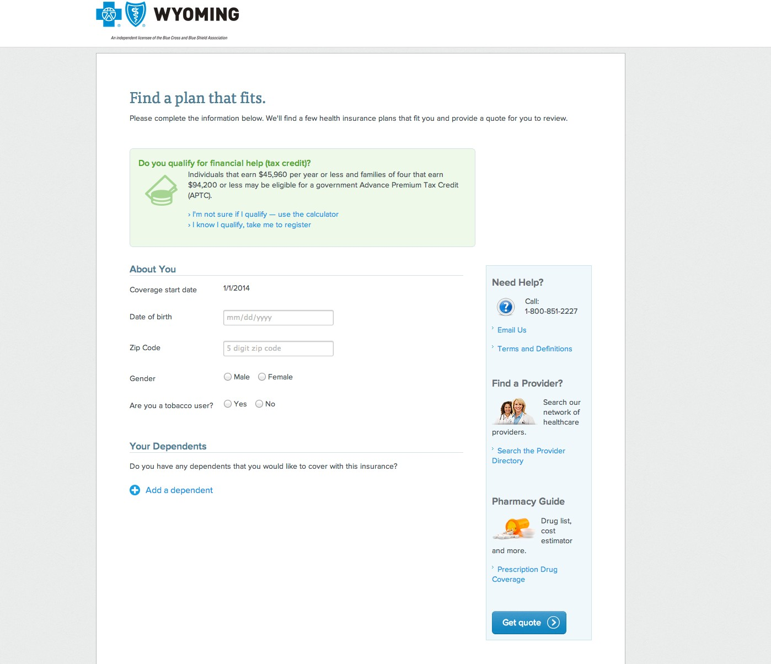

Slide 88
Example:
Login Examples

Slide 89
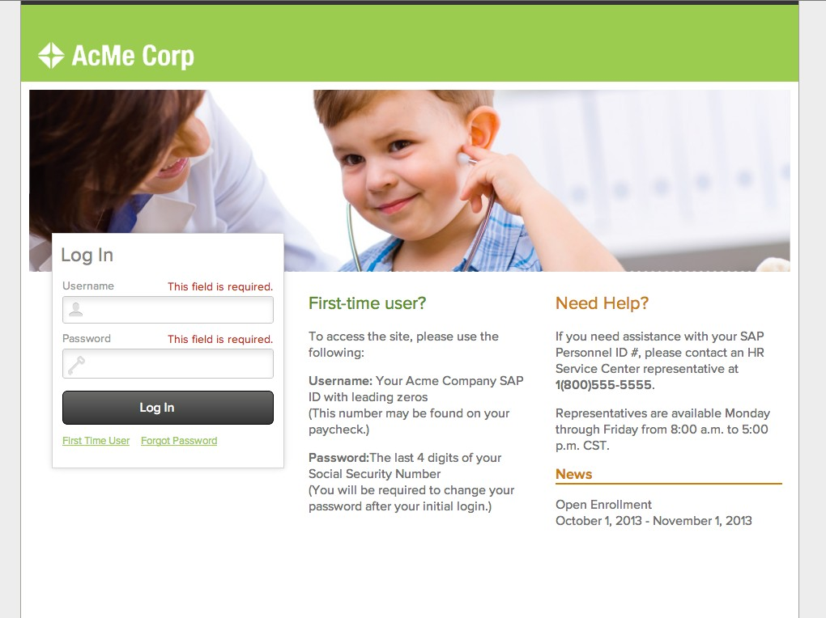

Slide 90


Slide 91
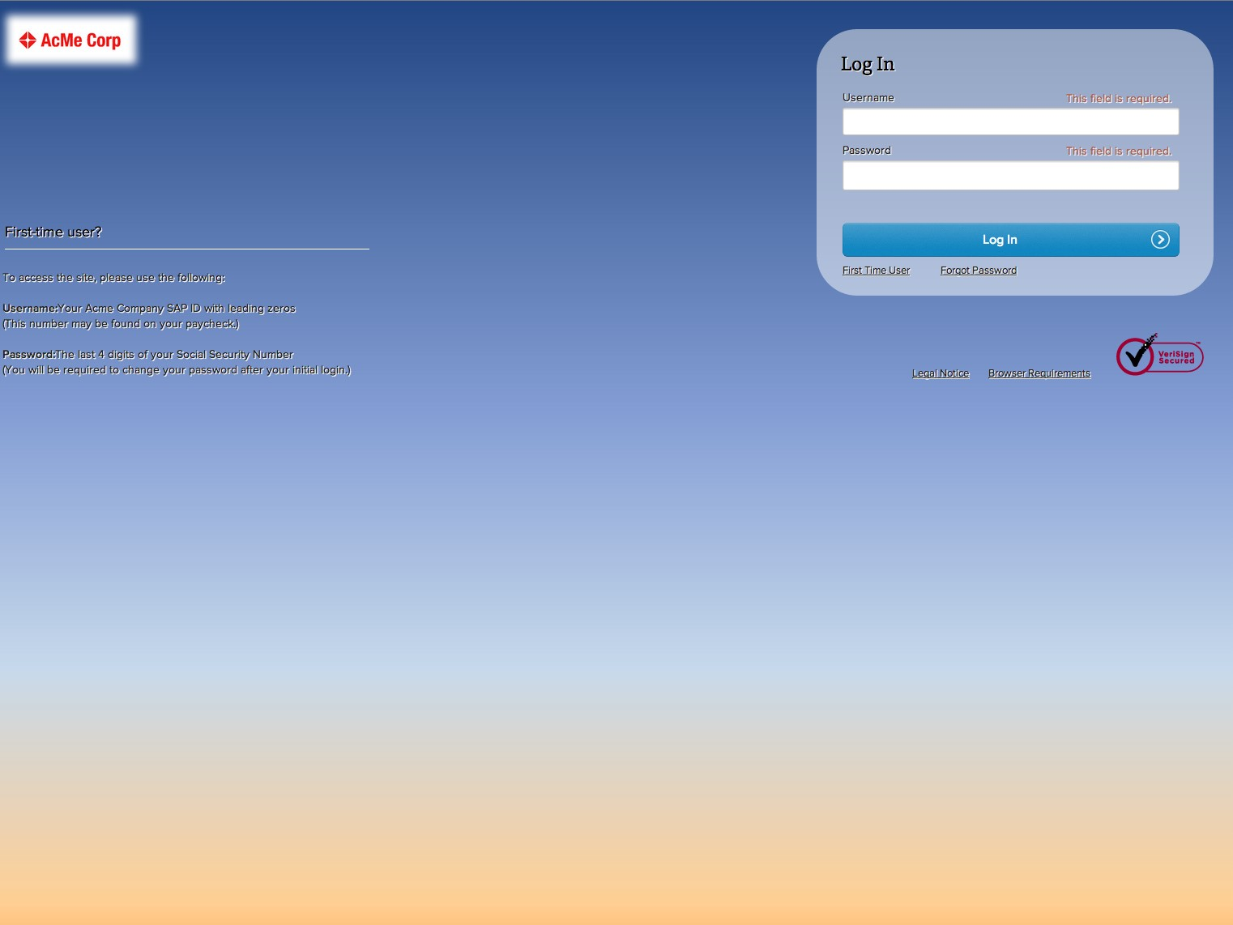

Slide 92


Slide 93
END NOTES
You are not expected to write your own html & css
If you do, please run it by the UX team Apply big changes only to ‘safe’ pages Make sure we aren’t just fixing symptoms
Don’t make changes that damage usability / readability / legibility

Slide 94
Tools

Slide 95
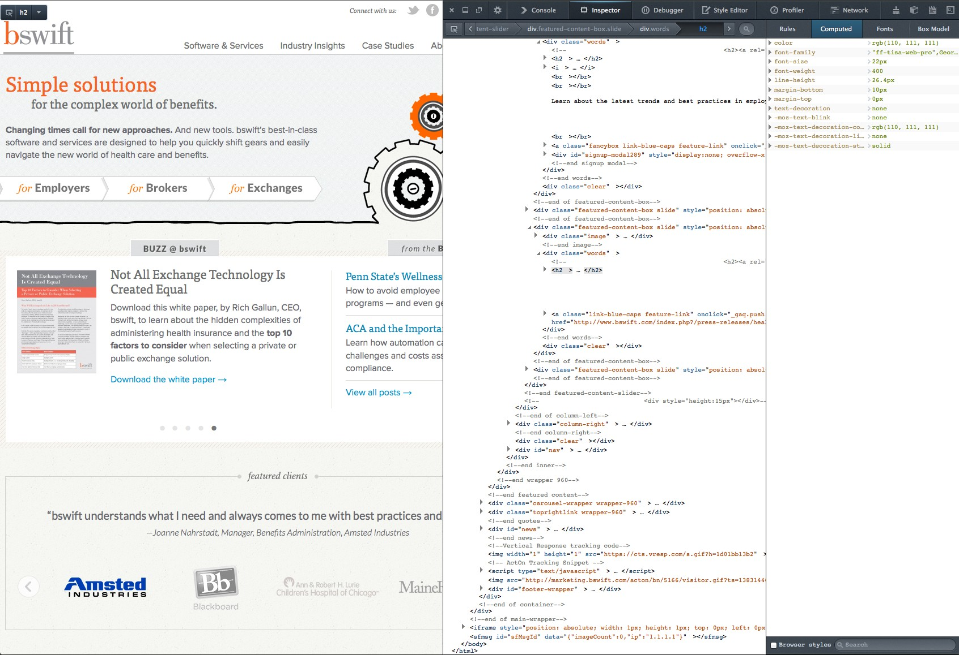

Slide 96
